Slide 1

LINKEDIN STATS

Slide 2
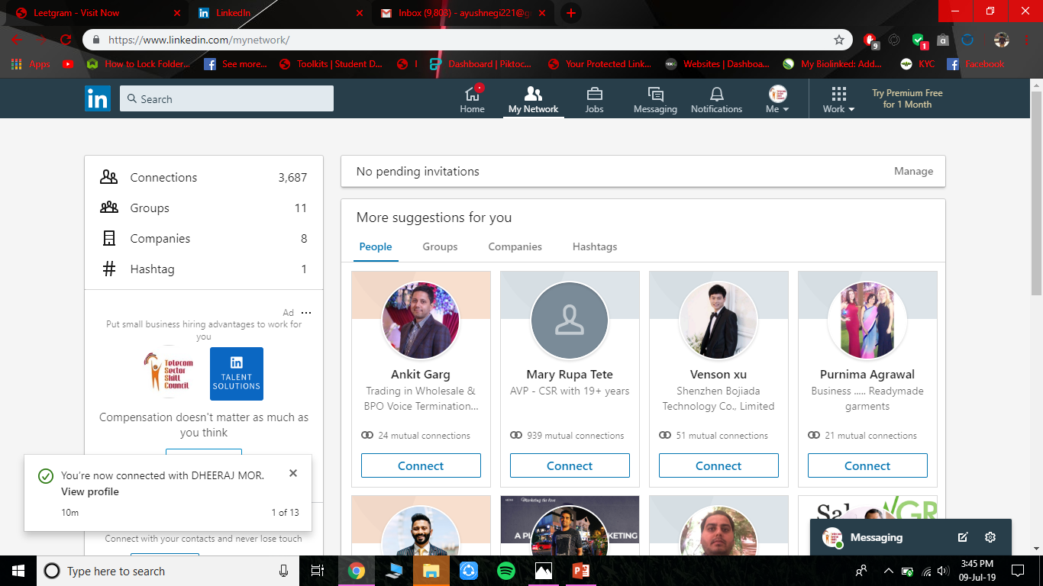
TOTAL CONNECTIONS
3716 PEOPLE CONNECTED ON LIKEDIN
CONNECTION FORM 3300 HAS INCREASED OVER AMOTH

Slide 3
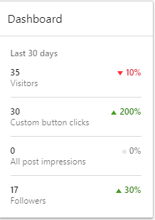
TOTAL FOLLOWERS
A TOTAL OF 1436 followers in LIKEDIN
Followers has increased from 1300 to 1436 and everyday people follow and send follow request to us for increasing connection

Slide 4
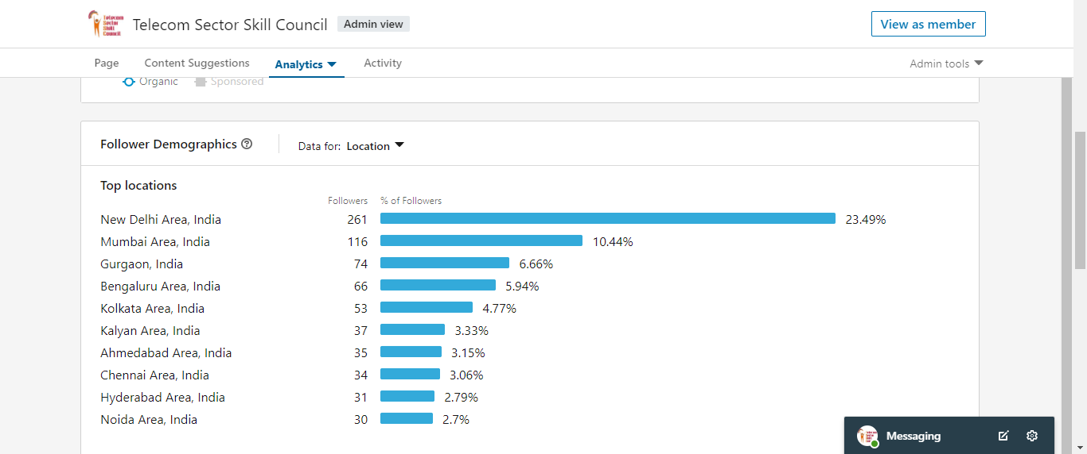
FOLLOWERS FROM THE LOCATION

Slide 5
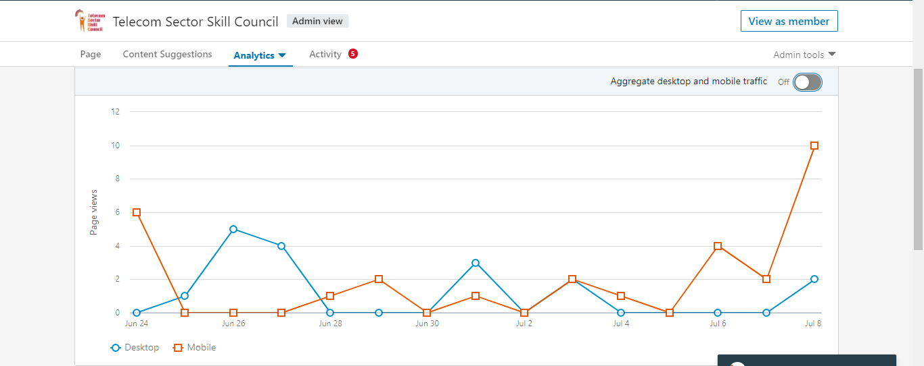
VIEWS AND SOURCES

Slide 6

POST WITH HIGEST VIEW

